Slide 1
SOFTWARE REQUIREMENTS ENGINEERING
1
LECTURE # 7
TEAM SKILL 2: UNDERSTANDING USER AND STAKEHOLDER NEEDS
REQUIREMENT ELICITATION TECHNIQUES-IV
Engr. Ali Javed
12th June, 2013

Slide 2
Presentation Outline
3
Prototyping
Why Prototyping in General
Uses of Prototyping
The Prototyping Process Types of Prototyping
Throwaway
Evolutionary
Horizontal
Vertical
User Interface
Objectives of Throwaway & Evolutionary Prototyping Low Fidelity Prototype
High Fidelity Prototype
Wizard of OZ Prototyping
Requirements Prototype What to Prototype Building the Prototype
Results Evaluation of Prototype Requirements Re-use
◻
◻
◻
◻
◻
◻
◻
◻
◻
◻
◻
◻
◻
Engr. Ali Javed

Slide 3
Requirements Elicitation Techniques
4
Interviews
Questionnaires
Background Reading
Introspection
Social Analysis
Requirements Workshops
Brainstorming and Idea Reduction
Story Boarding
Role Playing
Prototyping
Requirements Reuse
Engr. Ali Javed

Slide 4
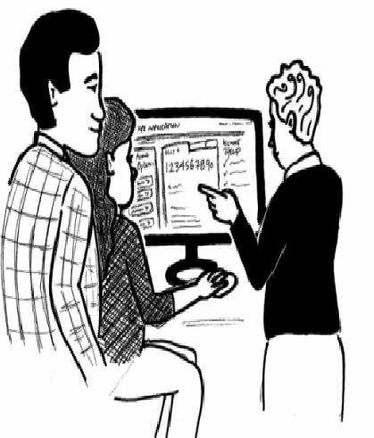
Prototyping
5
Prototyping is the rapid development of a system demonstrating a portion of the functionality of the new system
A prototype is an initial version of a system used to demonstrate concepts, elicits requirements and try out design options.
A prototype can be::
a storyboard, i.e. a cartoon-like series of
scenes
a video simulating the use of a system
a piece of software with limited functionality
written in the target language or in another language
Engr. Ali Javed

Slide 5
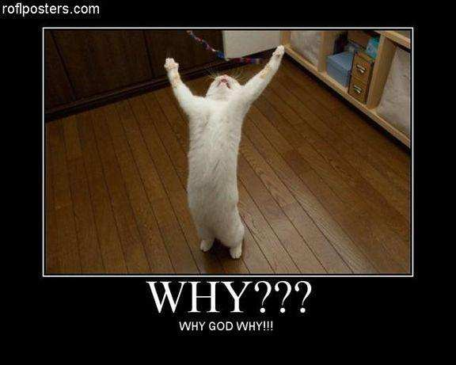
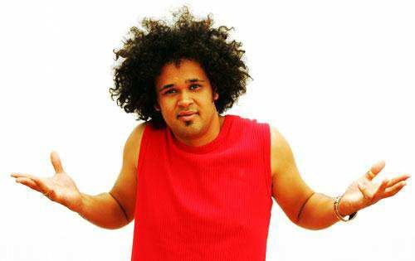
Why Prototype in General?
6
Evaluation and feedback process can be achieved successfully
Developers can test feasibility of ideas with team, users
Stakeholders can see and interact with a prototype more easily than a document
Team members and users can communicate effectively
To validate existing / other requirements
Prototypes answer questions, and support designers in choosing between alternatives
Engr. Ali Javed

Slide 6
Uses of Prototyping
7
The principal use is to help customers and developers understand the requirements for the system
Requirements elicitation. Users can experiment with a prototype to see how the system supports their work
Requirements validation. The prototype can reveal errors and omissions in the requirements
Prototyping can be used in situations where the users are unable to express their requirements
The prototype may be used for user training before a final system is delivered
The prototype may be used for back-to-back testing
Engr. Ali Javed

Slide 7
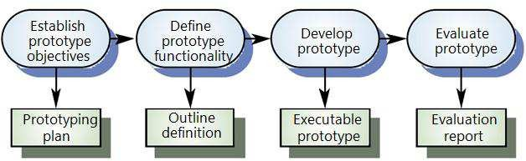
The Prototyping Process
8
Engr. Ali Javed

Slide 8
Types of Prototypes
9
Prototypes can be categorized in many ways::
Throwaway VS Evolutionary
Vertical VS Horizontal
User Interface VS Algorithmic
The type of Prototype chosen depends on the problem to be solved
For example, if your project risk is based primarily on the feasibility of the technology approach- its simply never have been done this way before and you are uncertain whether the applicable technology can achieve the performance or throughput goals- you may wish to develop an architectural prototype that primarily demonstrates the feasibility of the technology to be used
Engr. Ali Javed

Slide 9
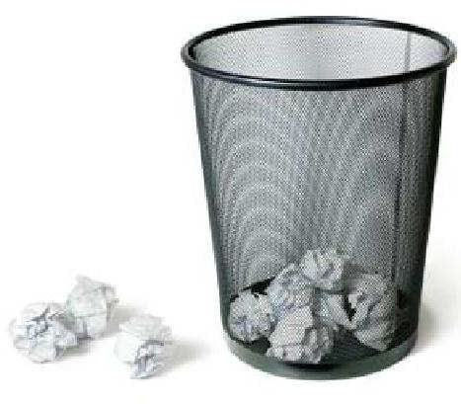

Throwaway Prototyping
10
Throwaway implies that the purpose of the effort is only to establish feasibility and you will use whatever shortcuts, alternative technologies, or whatever to achieve your goals
When you built prototype then simply throwaway the result, keeping only the knowledge learned in the exercise
The system is then developed using some other development process
The throw-away prototype should NOT be considered as a final system
Engr. Ali Javed

Slide 10
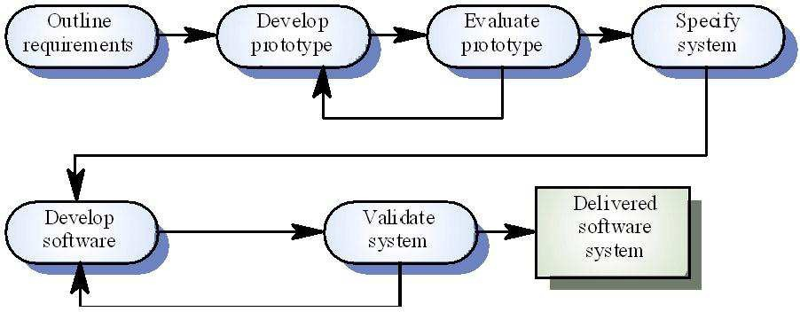
Throwaway Prototyping
11
Engr. Ali Javed

Slide 11
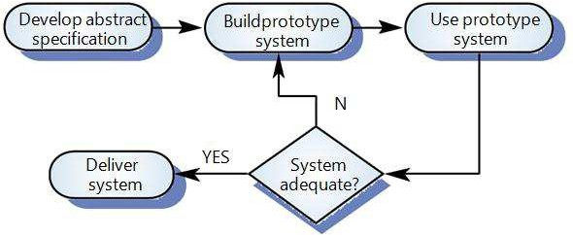
Evolutionary Prototyping
12
An approach to system development where an initial prototype is produced and refined through a number of stages to the final system
Evolutionary implies that you have implemented the prototype on the same architecture as you intend to use in the final system and will be able to build the final system by evolving the prototype
Techniques for rapid system development are used such as CASE tools
User interfaces are usually developed using a GUI development toolkit
Engr. Ali Javed

Slide 12

Objectives of Throwaway & Evolutionary Prototyping
13
The objective of throw-away prototyping is to validate or derive the system requirements.
The prototyping process
starts which
with those requirements
are poorly understood
The objective of evolutionary prototyping is to deliver a working system to end-users. The development starts with those requirements which are best understood.
Engr. Ali Javed

Slide 13
Horizontal Prototyping
14
Horizontal implies that we will attempt to construct the wide range of the system’s
requirements
Horizontal Prototyping keeps the features but eliminates the depth of functionality
For example we are developing a prototype of a system which includes 40 different features with each feature consists of several functionalities if we built prototype with covering all these features but not the detailed functionalities of these features then it means we built horizontal prototype
Engr. Ali Javed

Slide 14
Vertical Prototyping
15
Vertical prototype constructs just a few requirements but does so in a quality manner
Vertical Prototyping gives full functionality for a few features
For example we are developing a prototype of a system which includes 40 different features with each feature consists of several functionalities if we built prototype with covering some of these features but with the detailed functionalities of these features then it means we built vertical prototype
Engr. Ali Javed

Slide 15
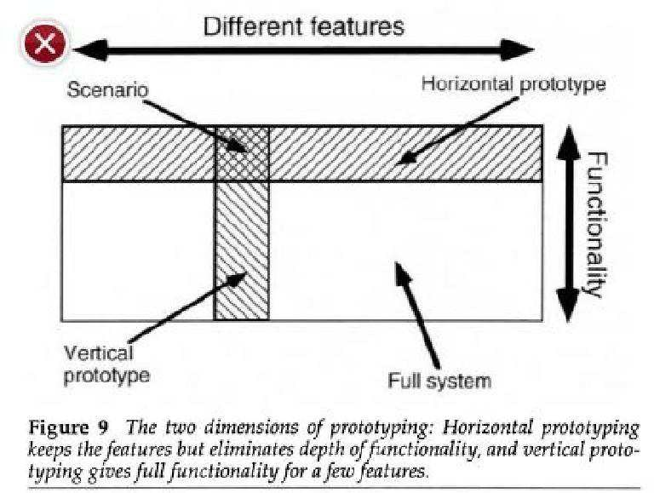
Horizontal VS Vertical Prototyping
16
Engr. Ali Javed

Slide 16
User Interface Prototyping
17
User Interface implies that
we will be constructing mostly the system’s
than implementing the logic and algorithms that
interface to its users rather
reside within the software
It is impossible to pre-specify the look and feel of a user interface in an effective way. prototyping is essential
UI development consumes an increasing part of overall system development costs
Prototyping may use very high level languages such as Smalltalk or Java or may include prolog and lisp mostly used in artificial intelligence
User interface generators may be used to “draw” the interface and mimic its functionality
Engr. Ali Javed

Slide 17
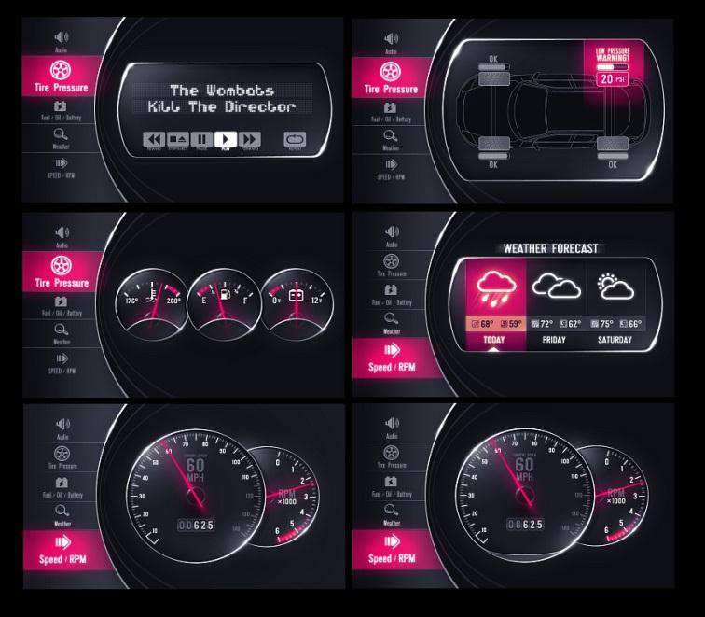
User Interface Prototyping
18
The aim is aesthetics.
In a GUI
to highlight strengths and weaknesses of the interface usability and
application, it would be expected that this form of prototyping
would include detailed icons, fonts, color scheme, interaction styles (e.g. single click, double click, rollover, short-cuts), use of audio (e.g. click sounds, warning sounds, etc).
The outcome of interface prototyping may highlight potential weaknesses, such as:
lack of short-cuts for expert users
awkward/confusing features (e.g. icon doesn't relate well to the function)
features that are poorly designed
inconsistencies in design across screens
Engr. Ali Javed

Slide 18

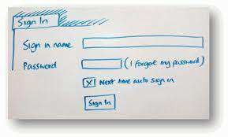
Low-fidelity Prototyping
19
Uses a
medium which is unlike the final medium, e.g. paper,
cardboard
Is quick, cheap and easily changed
Examples:
sketches of screens, task sequences, etc
“Post-it” notes
storyboards
Engr. Ali Javed

Slide 19
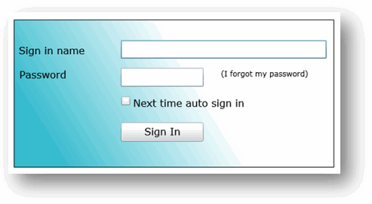
High-fidelity Prototyping
20
Uses materials that you would expect to be in the final product.
Prototype looks more like the final system than a low-fidelity version.
For a high-fidelity software prototype common environments include Macromedia Director, Visual Basic, and Smalltalk.
Danger that users think they have a full system but all prototypes involve compromises
Two common types of compromise are::
“horizontal‟: provide a wide range of functions, but with little detail
“vertical‟: provide a lot of detail for only a few functions
Engr. Ali Javed

Slide 20
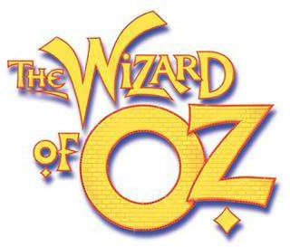
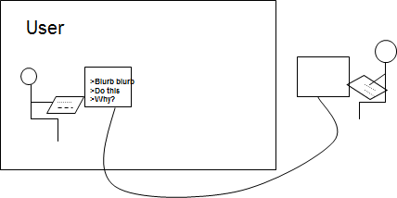
Wizard of Oz Prototyping
21
The user thinks they are interacting with a computer, but a developer is responding to output rather than the system.
Usually done early in design to understand users’ expectations
What is ‘wrong’ with this approach?
Engr. Ali Javed

Slide 21
Requirements Prototypes
22
Requirements implementation of
Prototype
can
a software system,
be defined as, “A partial built to help developers, users and
customers better understand the requirements of the system”
We can chose a combination of any of the prototypes discussed so far
For the purposes of requirements elicitation, we may often chose to build a
“throwaway, horizontal, user interface” prototype
As an elicitation tool such a prototype can serves its role in number of ways:
Built by the developer, it can be used to obtain customer confirmation that the developer
understands the requirements
Built by the developer, it can be used as a facilitator to encourage the customer of yet more requirements
Engr. Ali Javed

Slide 22
What to Prototype?
23
How do we know what portion of the system we need to prototype?
In a typical situation, our understanding of understood and easy to verbalize to totally unknown
the user’s needs will range from well
Well understood requirements are those requirements which might be obvious from the context of the application domain and the user’s and team’s experience with systems of that type
For example if we are simply extending an existing system, it’s clear what most of the new functionality needs to be
The well understood and well known requirements need not to be prototyped unless they are necessary to help visualize the context of other user needs; building them will consume scarce resources, but since they are already well understood, little will be learned from seeing them
Engr. Ali Javed

Slide 23

What to Prototype?
24
The unknown requirements, however are the “undiscovered ruins” that we are going to
wish we knew later
Unfortunately we cannot really prototype those either, for if we could, they would not be unknown
That leaves us as the target for prototyping the “fuzzy” part in the middle
These Fuzzy requirements are those that may be known, but they are poorly defined
and poorly understood
Engr. Ali Javed

Slide 24

Building the Prototype
25
The choice of language/technology in building the prototype depends on the following:
What is the application domain of the problem?
What user interaction is required?
Are you following throwaway or evolutionary approach?
Different parts of the system may be programmed in different languages.
For example, the choice for a throwaway GUI prototype is driven simply by whatever
technology provides the fastest, cheapest way to implement the sample GUI‟s
If an evolutionary prototype is selected, you must choose the implementation language and development environment that you will use in the production device
Engr. Ali Javed

Slide 25
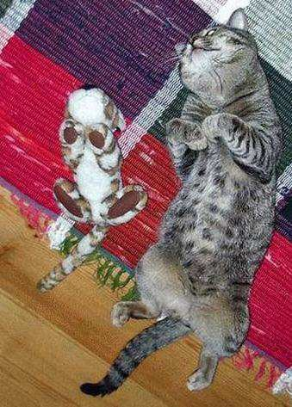
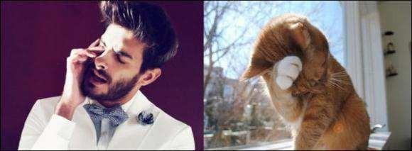
Result Evaluation
26
After the prototype is built, it should be exercised by its users in an environment that mimics as closely as possible the production environment in which the final system will be used
Also it will be important to have various types of user exercise the device or the results may be biased
Engr. Ali Javed

Slide 26
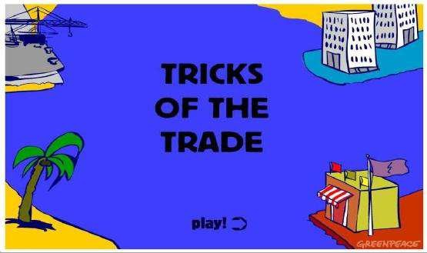
Result Evaluation
27
The results of prototype may be two fold:
Fuzzy needs become better understood
Exercising the prototype elicits a “Yes-But” response from the user; therefore previously unknown needs become known
In any case the prototyping always produces results
The trick is making sure that the return in requirements knowledge gained is worth
the investment made
Engr. Ali Javed

Slide 27

Requirements Reuse
28
In the field of software engineering reusing the requirements of the existing system is the common method of requirement elicitation
Using the existing knowledge to develop the new product has many advantages including low cost and less time
Engr. Ali Javed

Slide 28
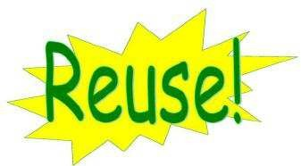
Requirements Reuse
29
Through each product has their own types of stakeholders and users, there is still number of situations that the reuse of requirements takes place e.g.
User interface design of the application domain information
Now a days in software industries the more than half of the requirements for the new project requirements are acquired from the existing projects
Although there is need to check the requirements before they are used in the proposed product, the reuse requirements are already validated and analyzed thus reducing the time for testing
Engr. Ali Javed

Slide 29
Requirements Reuse
30
The various questions that helps us to find the reusable requirements are::
What are the problems in the existing product?
What the proposed product should provide to overcome the difficulties in the existing product?
Who are the users and stakeholders of the existing and proposed products?
It is difficult to say the proposed product is completely different from the existing product because it is easy to find reused requirements in any project requirement specification
Finding and using the reusable requirements for the projects is the best way for Requirements Elicitation
Engr. Ali Javed

Slide 30

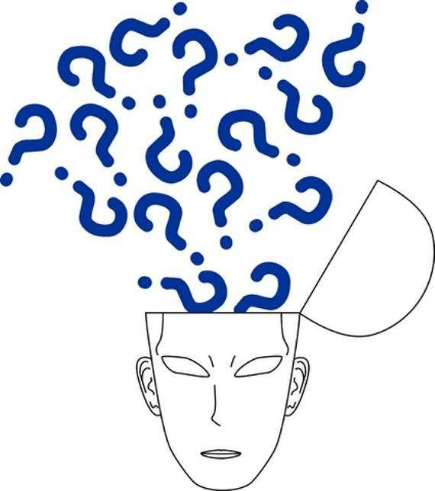
For any query Feel Free to ask
31
Engr. Ali Javed

